Slide 1
KNN and Decision Tree
Wen-Cheng Lin
Department of Medical Informatics
Tzu Chi University

Slide 2
KNN

Slide 3
Instance Based Learning
Key idea
  Just store all training examples (x_{i},f(x_{i}))
  Generalizing beyond these examples is postponed until a new instance must classified
    Each time a new query instance is encountered, its relationship to the previously stored examples is examined in order to assign a target function value for the new instance

Slide 4
Instance Based Learning
Can construct a different approximation to the target function for each distinct query instance
Disadvantage
  The cost of classifying new instances can be high
    Computation takes place at classification time
  Consider all attributes when attempting to retrieve similar training examples
    If the target concept dependents on only a few attributes, the instances that are truly most similar may be a large distance apart

Slide 5
k-Nearest Neighbor
Nearest neighbor
  Given query instance x_{q}, first locate nearest training example x_{n}, then estimate
k-Nearest neighbor
  Given x_{q}, take vote among its k nearest neighbors (if discrete-valued target function)
  Take mean of f values of k nearest neighbors (if real-valued)

Slide 6
k-Nearest Neighbor
Euclidean distance
  x: (a₁(x), a₂(x), …, a_{n}(x))
    a_{r}(x): the value of the rth attribute of instance x

Slide 7
k-Nearest Neighbor
Training algorithm
  For each training example (x,f(x)), add the example to the list training-examples
Classification algorithm
  Let x₁,…,x_{k} denote the k instances from training-examples that are nearest to x_{q}
  Return
    where δ(a,b)=1 if a=b and δ(a,b)=0 otherwise

Slide 8
Voronoi Diagram
1-NN: +
5-NN: -
1-NN
The convex polygon surrounding each training example indicates the region of instance space closest to that point

Slide 9
When to Consider Neighbor
Instances map to points in R^{n}
Lots of training data
Advantages
  Training is very fast
  Learn complex target functions
  Don’t lose information
Disadvantages
  Slow at query time
  Easily fooled by irrelevant attributes

Slide 10
Distance Weighted kNN
Might want weight nearer neighbors more heavily...
  where

Slide 11
Distance Weighted kNN
It can use all training examples to have an influence on the classification of the x_{q}
→ global method
It is robust to noisy training data
  It can smooth out the impact of isolated noisy training examples

Slide 12
Curse of Dimensionality
Imagine instances described by 20 attributes, but only 2 are relevant to target function
Curse of dimensionality
  The distance between neighbors will be dominated by the large number of irrelevant attributes
  The nearest neighbor is easily mislead when high-dimensional X

Slide 13
Curse of Dimensionality
One approach
  Stretch jth axis by weight z_{j}, where z₁, ..., z_{n} chosen to minimize prediction error
  Use cross-validation to automatically choose weights z₁, ..., z_{n}
  Note setting z_{j} to zero eliminates this dimension altogether
  Leave-one-out cross validation
    1 test data, m-1 training data

Slide 14
Locally Weighted Regression
Note kNN forms local approximation to f for each query point x_{q}
Why not form an explicit approximation f(x) for region surrounding x_{q}
  Fit linear, quadratic, or other function to k nearest neighbors
  Produces “piecewise approximation” to f

Slide 15
Locally Weighted Regression
Several choices of error to minimize
  Squared error over k nearest neighbors
  Distance-weighted squared error over all neighbors
  Combine 1 and 2

Slide 16
Locally Weighted Regression
For criterion 3, use gradient descent

Slide 17
Radial Basis Function Networks
Global approximation to target function, in terms of linear combination of local approximations
Used, e.g., for image classification, and computer animation
A different kind of neural networks
Closely related to distance-weighted regression, but “eager” instead of “lazy”

Slide 18
Radial Basis Function Networks
where a_{i}(x) are the attributes describing instance x, and
One common choice for K_{u}(d(x_{u},x)) is Gaussian kernel function

Slide 19
Training Radial Basis Function Networks
Q1: What x_{u} to use for each kernel function K_{u}(d(x_{u},x))?
  Use all training examples
    Allocate a kernel function for each training example
    Not efficient
  Use a subset of training examples
    Scatter uniformly throughout instance space
    Or use training instances (reflects instance distribution)
      Randomly select a subset of training examples, thereby sampling the underlying distribution
      Clustering, add a kernel function centered at each cluster

Slide 20
Training Radial Basis Function Networks
Q2: How to train weights (assume here Gaussian K_{u})?
  First choose variance and perhaps mean for each K_{u}
    e.g., use EM
  Then hold K_{u} fixed and train linear output layer
    efficient methods to fit linear function

Slide 21
Decision Tree

Slide 22
PlayTennis Problem

Slide 23
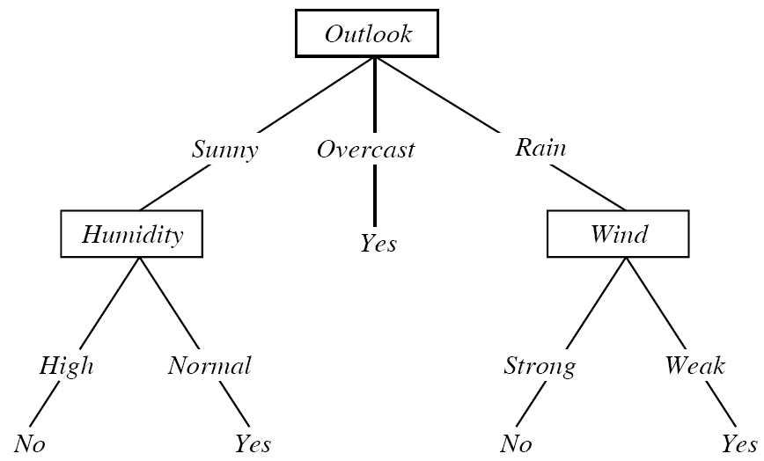
Decision Tree for PlayTennis

Slide 24
Decision Tree
Decision tree representation
  Each internal node tests an attribute
  Each branch corresponds to attribute value
  Each leaf node assigns a classification
Classify new instance
  Start at the root node and move down to a leaf, test the attribute specified by this node, then moving down to the tree branch corresponding to the value of the attribute in the instance.

Slide 25
Decision Tree
Decision trees represent a disjunction of conjunctions of constraints on the attribute values of instances
  Each path from the root to a leaf corresponds to a conjunction of attribute tests
  The tree itself corresponds to a disjunction of these conjunctions
    (Outlook=Sunny ∧ Humidity=Normal)
    ∨ (Outlook=Overcast)
    ∨ (Outlook=Rain ∧ Wind=Weak)

Slide 26
Appropriate Problem for Decision Tree Learning
Instances are represented by attribute-value pairs
Target function has discrete output values
  Yes or no in PlayTennis problem
Disjunctive descriptions may be required
  Decision trees naturally represent disjunctive expressions

Slide 27
Appropriate Problem for Decision Tree Learning
The training data may contain errors
  Decision tree learning methods are robust to errors in classifications of training examples and errors in the attribute values of training examples
The training data may contain missing attribute values
Examples
  Classify medical patients by their disease
  Classify equipment malfunctions by their cause

Slide 28
Basic Decision Tree Learning Algorithm
Top-down, greedy search through the space of possible decision trees
ID3
  “Which attribute should be tested at the root?”
  Each attribute is evaluated using a statistical test to determine how well it alone classifies the training examples
  The best attribute is selected and used as the test at the root node
  Create descendant and sort the training examples to the appropriate descendant node

Slide 29
ID3 Algorithm Specialized to Learn Boolean-Valued Functions
ID3(Examples, Target_attribute, Attributes)
  Create a Root node for the tree
  If all Examples are positive, return the single-node Root, with label = +
  If all Examples are negative, return the single-node Root, with label = -
  If Attributes is empty, return the single-node tree Root, with label = most common value of Target_attribute in Examples
  Otherwise Begin
    A ←the attribute from Attributes that best classifies Examples
    The decision attribute for Root ← A
    For each possible value, v_{i}, of A,
      Add a new tree branch below Root, corresponding to the test A=v_{i}
      Let Examples_{vi} be the subset of Examples that have value v_{i} for A
      If Examples_{vi} is empty
        Then below this new branch add a leaf node with label = most common value of Target_attribute in Examples
        Else below this new branch add the subtree
        ID3(Examples_{vi}, Target_attribute, Attributes-{A})
  End
  Return Root

Slide 30
Which Attribute Is Best?
The central choice in ID3 algorithm is selecting which attribute to test at each node in the tree
We would like to select the attribute that is most useful for classifying examples
ID3 selects the attribute that provides the highest information gain

Slide 31
Entropy (Boolean Classification)
S is a sample of training examples
p is the proportion of positive examples in S
p⊝ is the proportion of negative examples in S
Entropy measures the impurity of S
  Entropy(S) ≡ –plog₂p – p⊝log₂p⊝
  0log0=0

Slide 32
Entropy (Boolean Classification)
S: 9 positive, 5 negative examples [9+,5-]
  Entropy([9+,5-])
  = –(9/14)log₂(9/14) – (5/14)log₂(5/14)
  =0.94
Entropy is 0 if all members of S belong to the same class
  All positive
    Entropy(S)= -1log₂(1) – 0log₂(0)=0
Entropy is 1 when the collection contains an equal number of positive and negative examples

Slide 33
Entropy (Boolean Classification)

Slide 34
Entropy
Entropy(S) = expected number of bits needed to encode class ( or ⊝) of randomly drawn member of S (under the optimal, shortest-length code)
  Information theory
    Optimal length code assigns –log₂p bits to message having probability p
  So expected number of bits to encode  or ⊝ of random member of S:
    p(– log₂p) + p⊝(– log₂p⊝)

Slide 35
Entropy
c class
p_{i} is the proportion of S belonging to class i
The entropy can be as large as log₂c

Slide 36
Information Gain
Gain(S,A) = expected reduction in entropy caused by partitioning the examples according to attribute A
Values(A) is the set of all possible values for attribute A
S_{v} is the subset of S for which attribute A has value v

Slide 37
Example
Information gain is the measure used by ID3 to select the best attribute at each step in growing the tree
Training examples

Slide 38
Example

Slide 39
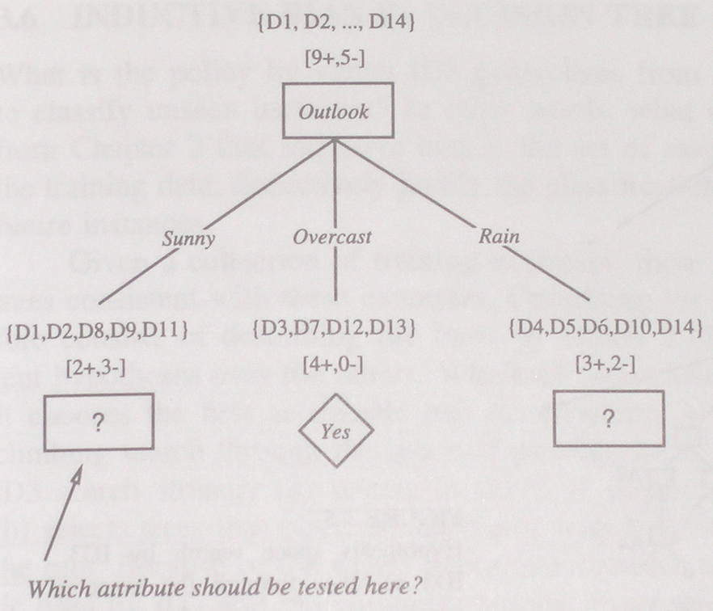
Example

Slide 40
Example
Root node
  Gain(S,Outlook)=0.246
  Gain(S,Humidity)=0.151
  Gain(S,Wind)=0.048
  Gain(S,Temperature)=0.029
S_{sunny}={D1,D2,D8,D9,D11}
  Gain(S_{sunny},Humidity)=0.97-(3/5)0.0-(2/5)0.0=0.97
  Gain(S_{sunny}, Temperature)=0.97-(2/5)0.0-(2/5)1.0-(1/5)0.0=0.57
  Gain(S_{sunny},Wind)=0.97-(2/5)1.0-(3/5)0.918=0.019

Slide 41
Overfitting in Decision Trees
Consider adding noisy training example #15:
  Sunny, Hot, Normal, Strong, PlayTennis = No
  What effect on earlier tree?

Slide 42
Overfitting in Decision Trees
  The new decision tree h is more complex than the original tree h’
  h will fit the noisy training examples perfectly, whereas h’ will not
  We expect h’ to outperform h over subsequent data

Slide 43
Overfitting
A hypothesis overfits the training examples if some other hypothesis that fits the training examples less well actually performs better over the entire distribution of instances

Slide 44
Overfitting
Consider error of hypothesis h over
  training data: error_{train}(h)
  entire distribution D of data: error_{D}(h)
Hypothesis h ∈ H overfits training data if there is an alternative hypothesis h’ ∈ H such that
  error_{train}(h) < error_{train}(h’)
  and
  error_{D}(h) > error_{D}(h’)

Slide 45
Overfitting

Slide 46
Avoiding Overfitting
Why overfitting occurs?
  The training examples contain errors
  The number of training examples is too small to produce a representative sample of the true target function
How can we avoid overfitting
  Stop growing when data split not statistically significant
  Grow full tree then post-prune

Slide 47
Avoiding Overfitting
How to select best tree
  Measure performance over separate validation data set
  Use all training data, apply a statistical test to estimate whether expanding (or pruning) a particular node is likely to produce an improvement beyond the training set
  Minimum Description Length
    Minimize size(tree) + size(misclassifications(tree))

Slide 48
Reduced-Error Pruning
Consider each of the decision nodes in the tree to be candidates for pruning
Pruning
  Remove the subtree rooted at the node
  Make it a leaf node
  Assign it the most common classification of the training examples affiliated with the node
Nodes are removed only if the resulting pruned tree performs better over the validation set

Slide 49
Reduced-Error Pruning
Split data into training and validation set
Do until further pruning is harmful
  Evaluate impact on validation set of pruning each possible node
  Greedily remove the one that most improves validation set accuracy
Produces smallest version of most accurate subtree
What if data is limited?

Slide 50
Reduced-Error Pruning

Slide 51
Rule Post-Pruning
Infer the decision tree from the training set (allowing overfitting)
Convert the learned tree into an equivalent set of rules
Prune (generalize) each rule by removing any preconditions that result in improving its estimated accuracy
Sort the pruned rules by their estimated accuracy, and consider them in this sequence when classifying subsequent instances

Slide 52
Rule Post-Pruning
Estimate rule accuracy
  Use a validation set
  Use a pessimistic estimate over the training set (used by C4.5)
pessimistic estimate

Slide 53
Continuous Valued Attributes
If some of the attributes are continuous
  Dynamically defining new discrete-valued attributes that partition the continuous attribute value into a discrete set of intervals
    A_{c} is true if A<c
  Select the best value for c
    Pick c that produces the greatest information gain

Slide 54
Continuous Valued Attributes
Sort the examples according to the attribute A
Identify adjacent examples that differ in their target classification
  Generate candidate thresholds between the corresponding values of A
Temperature | 40 48 60 72 80 90
PlayTennis | No No Yes Yes Yes No
54 85
Temperature_{>54} Temperature_{>85}

Slide 55
Continuous Valued Attributes
Compute the information gain associate with each threshold
Select the candidate attribute that has highest information gain as the new attribute
  Gain(S,Temperature_{>54}) > Gain(S,Temperature_{>85})
  The new attribute is Temperature_{>54}

Slide 56
Attributes with Many Values
Information gain measure favors attributes with many values
  Attribute Date (e.g. 10_Oct_2005)
    Have highest information gain
      Date perfectly predicts the target attribute over the training data
    Date will be selected as the decision attribute for the root node
    The learned decision tree will perfectly classify the training data, but poorly on subsequent examples

Slide 57
Attributes with Many Values
Use GainRatio instead
S_{i} is the subset of S partitioned by the c-valued attribute A
SpliteInformation measures how broadly and uniformly the attribute splits the examples
Discourage the selection of attributes with many uniformly distributed values

Slide 58
Attributes with Many Values
GainRatio will be undefined or very large when |S_{i}| ≈ |S| for one of the S_{i}
  Alternative
    First calculate the Gain of each attribute, then apply the GainRatio test only considering those attributes with above average Gain
    Each attribute is evaluated based on the distance between the data partition it creates and the perfect partition

Slide 59
Unknown Attribute Values
What if some examples missing values of A?
  Use the training example <x,c(x)> anyway, sort through tree
    If node n tests A, assign x the most common value of A among other examples at node n
    Assign x most common value of A among other examples at node n that have the same target value c(x)
    Assign probability p_{i} to each possible value v_{i} of A
      assign fraction p_{i} of example to each descendant in tree
  Classify new examples in same fashion

Slide 60
Attributes with Costs
In some learning tasks the instance attributes may have associated costs
  medical diagnosis, BloodTest has cost $150
We would prefer decision trees that use low-cost attributes where possible, relying on high-cost attributes only when needed to produce reliable classifications

Slide 61
Attributes with Costs
How to learn a consistent tree with low expected cost ?
  One approach replace gain by
    Tan and Schlimmer (1990)
    Nunez (1988)
      where w ∈ [0,1] determines importance of cost

Slide 62
Random Forest
Construct many decision trees at training time
Output the class that is the mode of the classes (classification) or mean prediction (regression) of the individual trees
Why
  A decision tree tends to be overfitting training set
  The average of many trees is not highly sensitive to noise in training set, as long as the trees are not correlated.

Slide 63
Tree Bagging (Bootstrap aggregating)
Given a training set X = x₁, ..., x_{n} with responses Y = y₁, ..., y_{n}
Bagging repeatedly (B times) selects a random sample with replacement of the training set and fits trees to these samples
  For b = 1, ..., B:
    Sample, with replacement, n training examples from X, Y; call these X_{b}, Y_{b}.
    Train a classification or regression tree f_{b} on X_{b}, Y_{b}.
Prediction for unseen samples x'
  Averaging the predictions from all the individual regression trees on x'
  or by taking the majority vote in the case of classification trees

Slide 64
From Bagging to Random Forests
Random subspace
  Select a random subset of the features at each candidate split in the learning process
  Typically setting
    For classification problem with p features, √p (rounded down) features are used in each split.
    For regression problems, p/3 (rounded down) with a minimum node size of 5 as the default.

